Slide 1
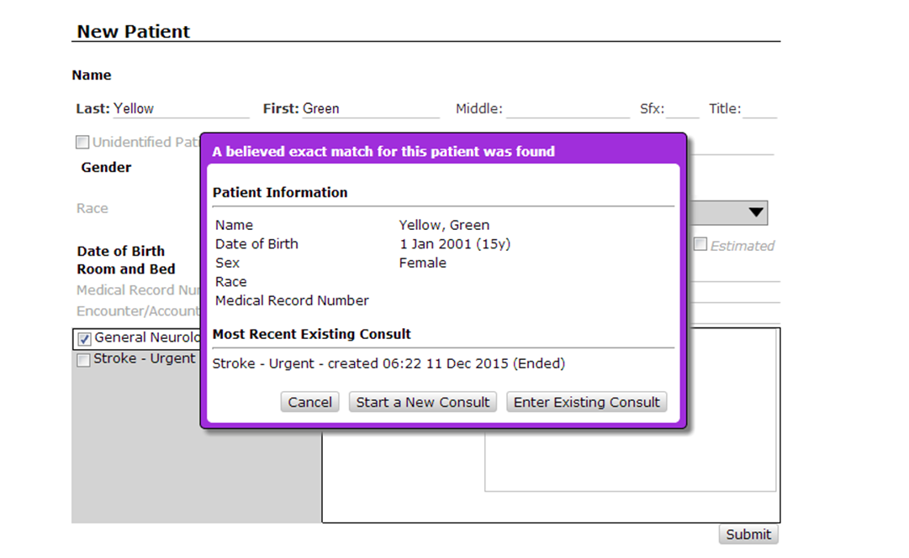
Re-Consult Process
Always select Start New Consult

